Slide 1
The design and implementation of a system for the automatic inference of necessary preconditions
P.&R. Cousot, M. Fahndrich, F. Logozzo

Slide 2
The problem
Automatically infer preconditions
Why?
Inter-procedural analysis
Code fixes
What is a precondition?
{P} C {Q}
So we have a solution?
{wp⟦C⟧Q} C {Q}
Well, no…

Slide 3
Weakest-precondition based inference
WP rule out good runs
Loops are a problem with WP
In deductive verification, provide a loop invariant
Over-approximation of the loop behavior
The result is no more the weakest precondition of the method
WP + Loop invariants provide sufficient preconditions
In practice, asking too much to the caller!
User feedback reported them as “wrong”
public static void WPex(int[] a)
{
for (var i = 0; i <= a.Length; i++)
{
a[i] = 11;
if (NonDet()) return;
}
}
WP = false

Slide 4

Our approach
Infer necessary preconditions
If violated, the program will go wrong for sure
(Informal) Requirements for necessary preconditions
No new run is introduced
No good run is eliminated
Therefore, only bad runs are eliminated
Example:
public static void WPex(int[] a)
{
for (var i = 0; i <= a.Length; i++)
{
a[i] = 11;
if (NonDet()) return;
}
}
Clousot infers:

Slide 5
Inference algorithm
For each method m
Run Clousot to discover invariants I
For each assertion p
Decide(I, p) = True, Bottom → do nothing
Decide(I, p) = False, Top → try infer a precondition for p
Simplify all the inferred preconditions
Propagate the inferred preconditions to the callers
Several algorithms to infer necessary preconditions
By abstraction of trace semantics formulation of the problem

Slide 6
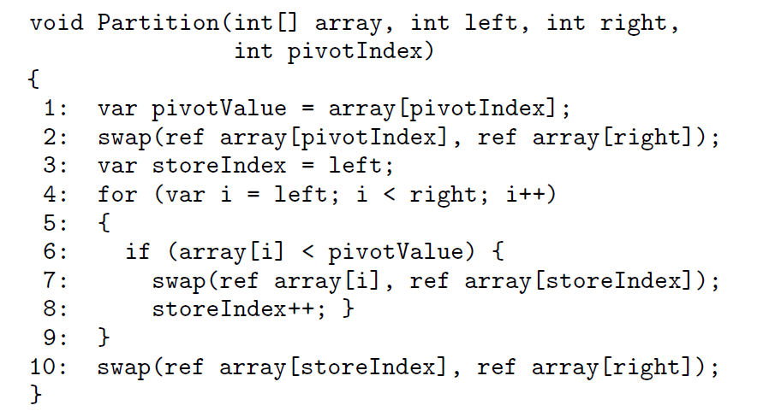
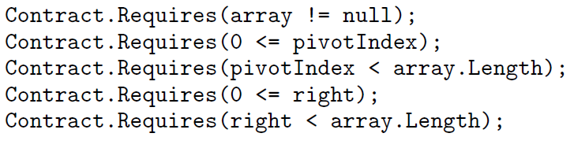
All-paths precondition analysis (APPA)
Idea:
Candidate assertions are checked in every path from entry
Variables in the assertion are unmodified
Example
Unchecked if left ≥ right
Store index may change

Slide 7

Conditional-paths precondition analysis (CPPA)
Idea:
Take into account path conditions
Compute (backwards) fixpoints
Example
The necessary preconditions are also sufficient
Re-run Clousot on the instrumented code
Weaker preconditions than usual formulation
0 ≤ left < right

Slide 8
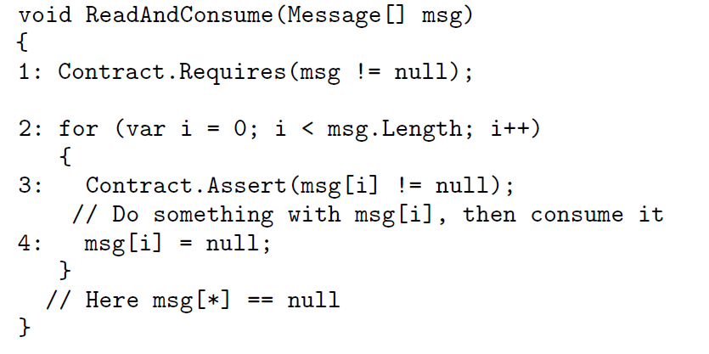

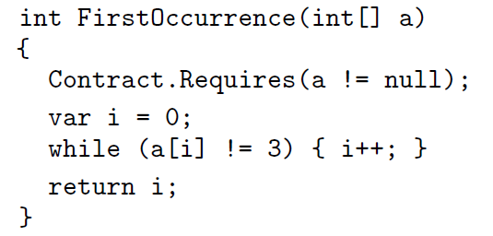
Quantified Preconditions
Universally
Existentially
Necessary & sufficient
Necessary, not sufficient
Also infer existential

Slide 9
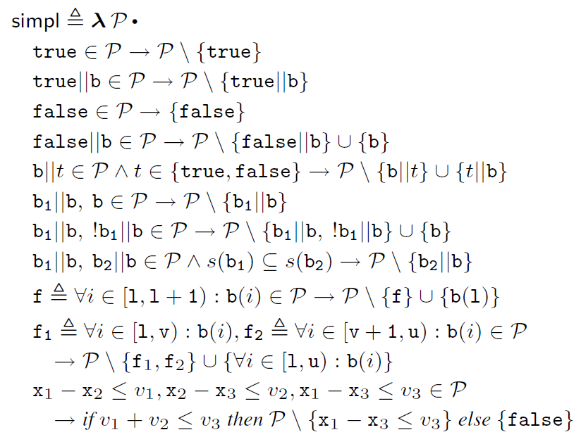
Simplification
Needed to filter, simplify, pretty print preconditions
Iterate to a fixpoint:

Slide 10
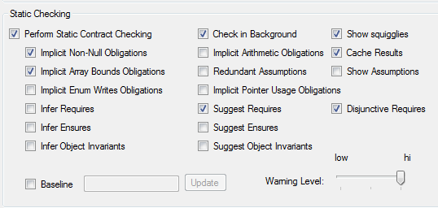
Experiments
All algorithms implemented in Clousot
Benchmarks
.NET assemblies
No contracts
Facebook C# SDK
With Contracts, on CodePlex
Evaluation problem
Raw # of preconditions not necessarily indicative
E.g. preconditions are simplified
Chaotic effect: the more the preconditions, the more the checks
Interested in # sufficient preconditions
Sufficient means no warnings for the method

Slide 11
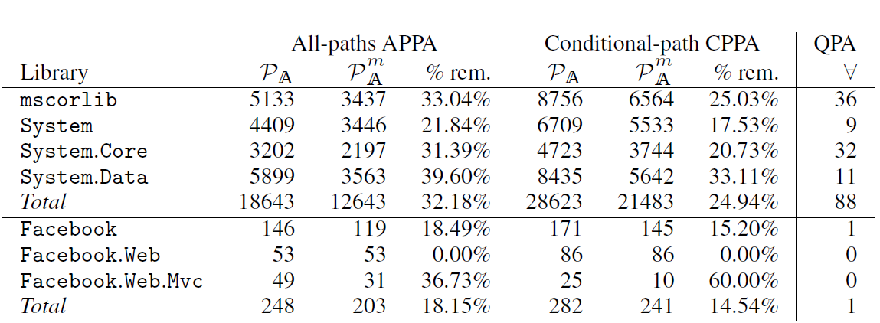
Inferred preconditions
Simplification is effective
System libraries remove up to 32% of inferred preconditions
CPPA infers way more preconditions than APPA
Slower
Too complex preconditions?

Slide 12
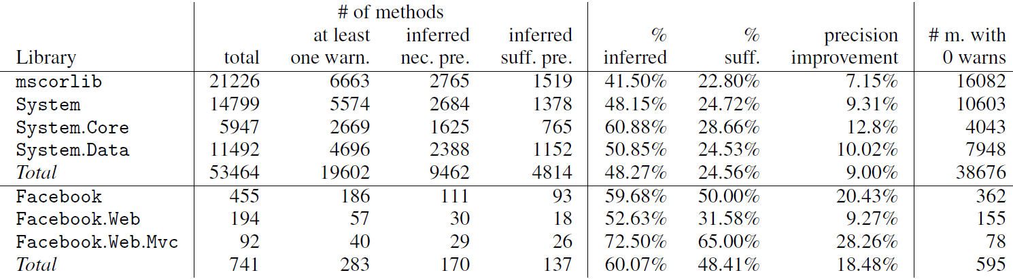
All-Paths precondition analysis
Inferred preconditions sufficient to go to 0 warnings
~25% methods with warnings in framework assembly
~48% methods with warnings in Facebook SDK
Similar results for CPPA
What is missing?
Object invariants, , postconditions, interfaces, extern methods …

Slide 13
Conclusions
Semantic-based design of precondition inference system
Unlike previous (hand waving-based) ones
Precondition inference algorithms
Atomic: All paths and conditional paths
Quantified: Universally and existential
Fully implemented in Clousot
Extended to
Integrate with Roslyn
Preconditions are code fixes
Automatically generate code transformations to fix bugs

